Slide 1
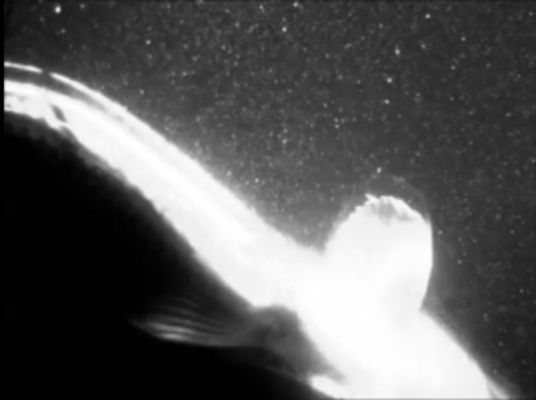
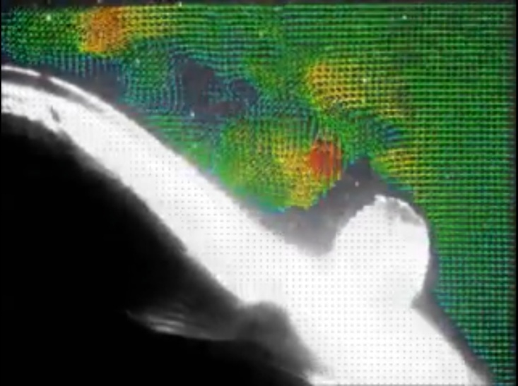
NYU Summer project for the Machine Learning in Fluid Dynamics
Nyu assignment 2021
-Akhilesh Kapse

Slide 2
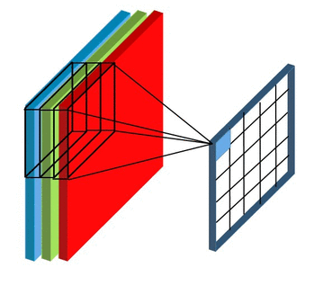

WHY CNN’s
● Data or image is convolved using filters or kernels. Filters are small units that we apply across the data through a sliding window. The depth of the image is the same as the input, for a color image that RGB value of depth is 3, a filter of depth 3 would also be applied to it. This process involves taking the element-wise product of filters in the image and then summing those specific values for every sliding action.
● There is a Convolutional Layer,
Activation Layer, Pooling Layer,
and Fully Connected Layer,
these are all interconnected so
that CNNs can process and
perceive data in order to classify
images.
● CNNs are used in variety of areas, including image and pattern recognition, speech recognition, natural language processing, and video analysis. There are a number of reasons that convolutional neural networks are becoming important.

Slide 3
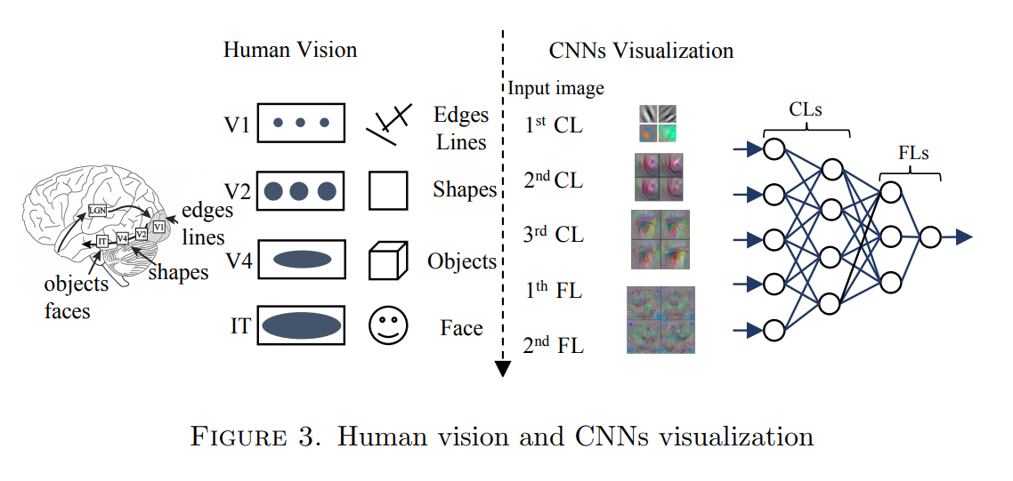
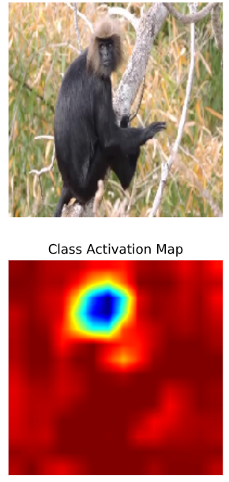
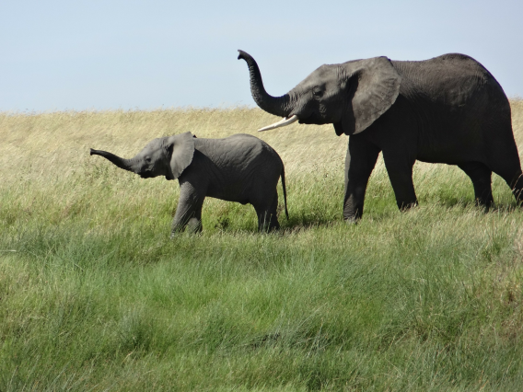
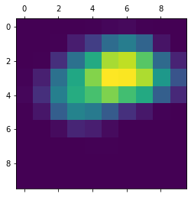
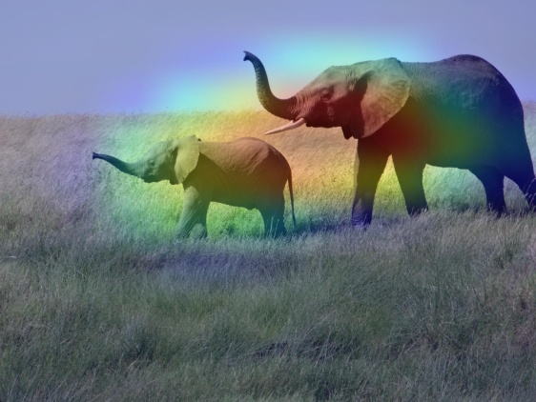
What actually
CNN SEE?
PAPER
Grad-CAM class activation visualization [blog]

Slide 4
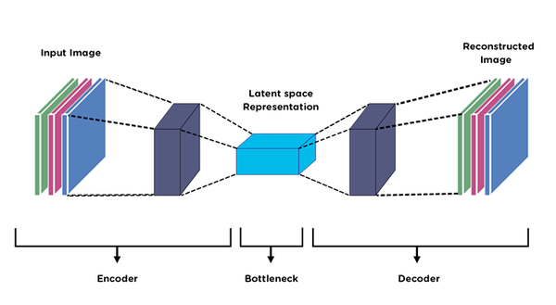
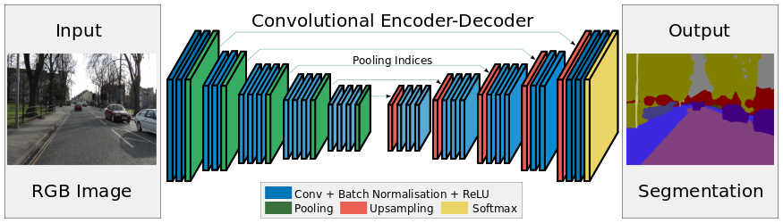
Auto-Encoders and its Applications
Auto-Encoder is a Convolutional neural network that learns how to efficiently compress and encode data then learns how to reconstruct the data back from the reduced encoded representation to a respected output we need i.e. segmentation, or representation that is as close to the original input as possible.
Applications-
▪ Dimensionality reduction
▪ Data compression
▪ Clustering
▪ Image Segmentation
▪ Auto-encoder for Anomaly Detection
▪ Image Denoising
▪ Capturing valuable features

Slide 5
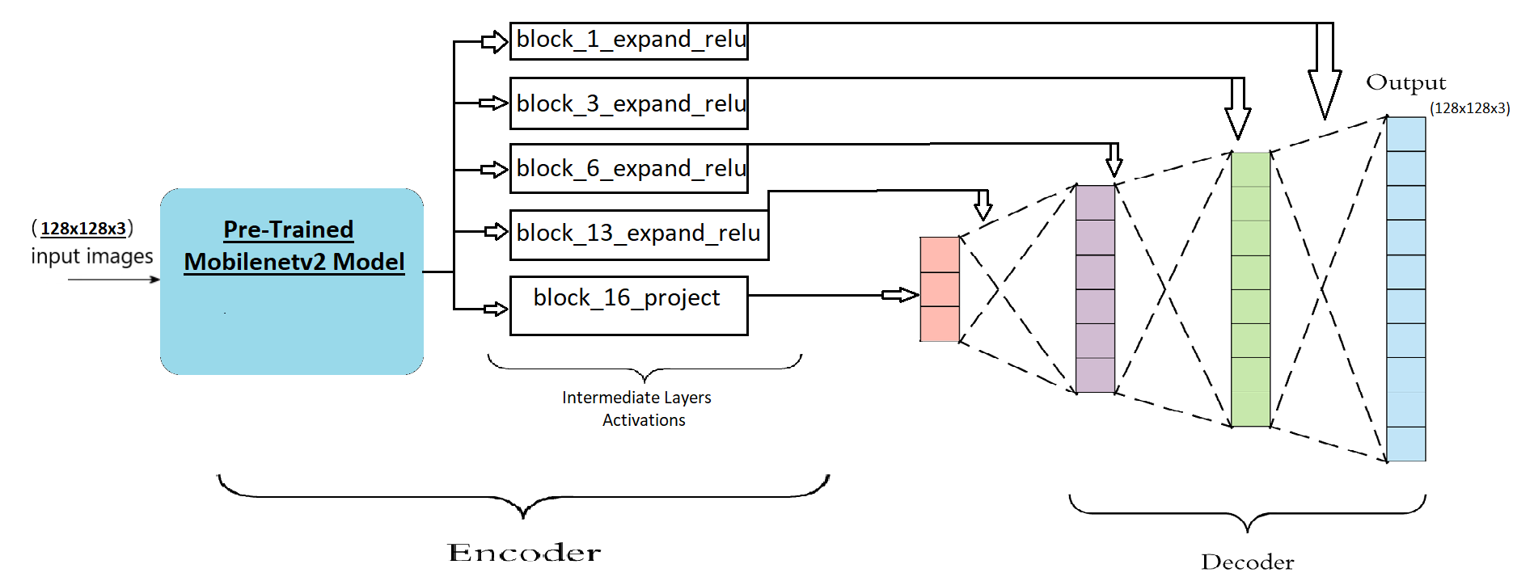
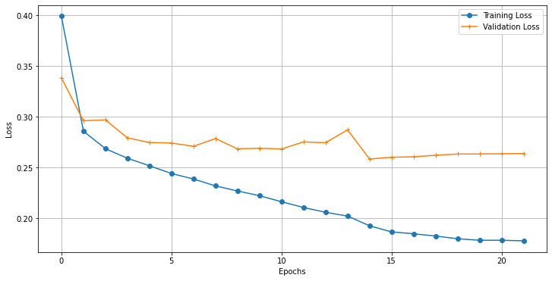
Tensorflow Image segmentation Tutorial
MODEL used for Instance Segmentation:
Evaluation metrics
(SparseCategoricalCrossentropy):

Slide 6
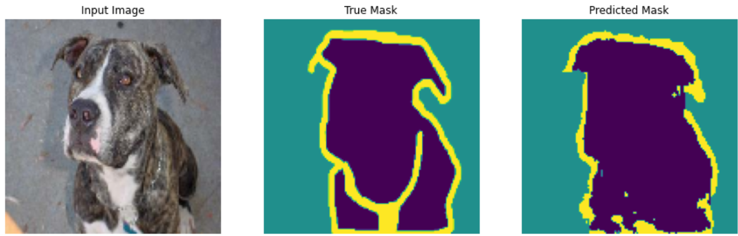
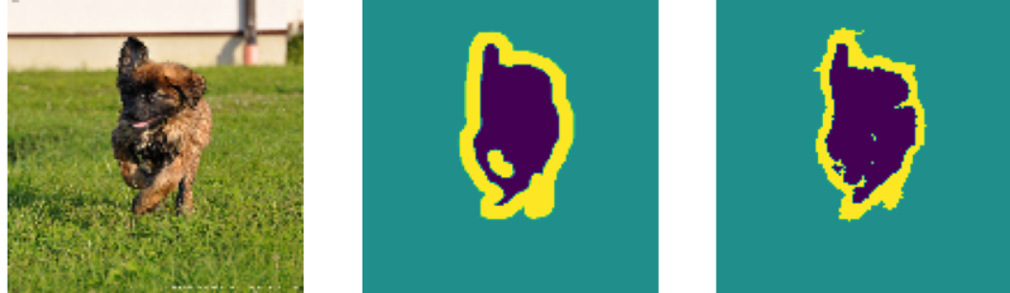
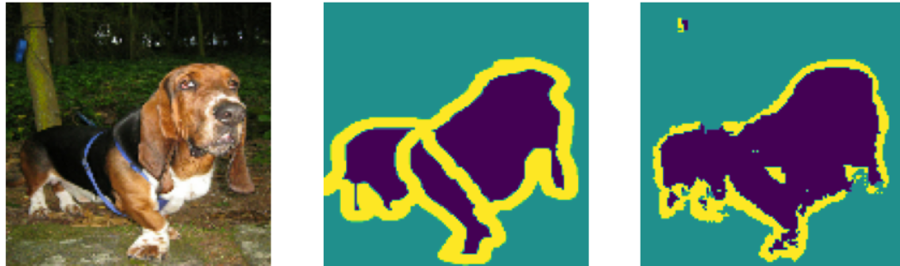
Results achieved:

Slide 7
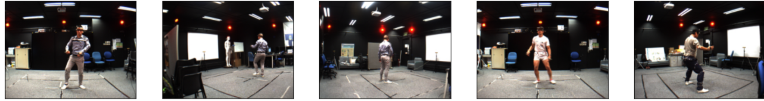
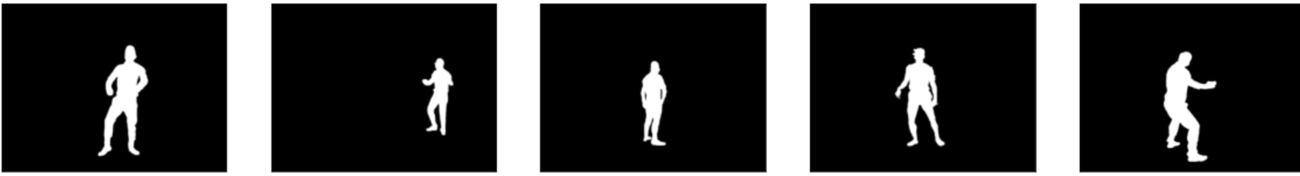
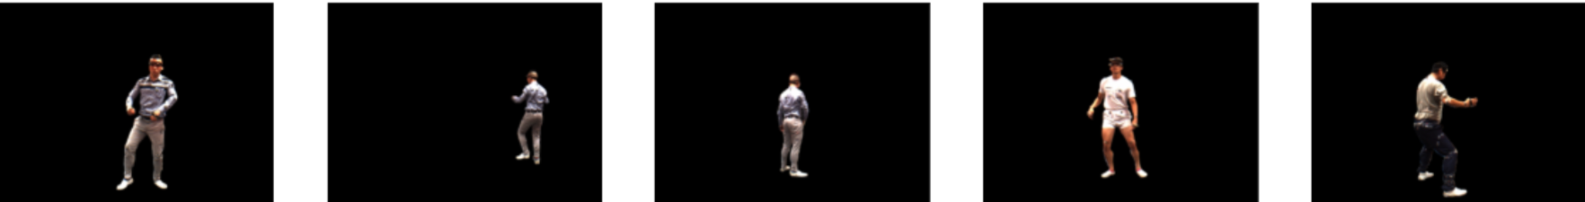
Using Another Dataset:
Human pose estimation is one of the most popular research topics in the past two decades, especially with the introduction of human pose datasets for benchmark evaluation.
The data was recorded in a studio environment with some background clutter. The MADS dataset contains 5 action categories (Tai-chi, Karate, Jazz dance, Hip-hop dance, and Sports)
Image
Mask
Ground-Truth

Slide 8
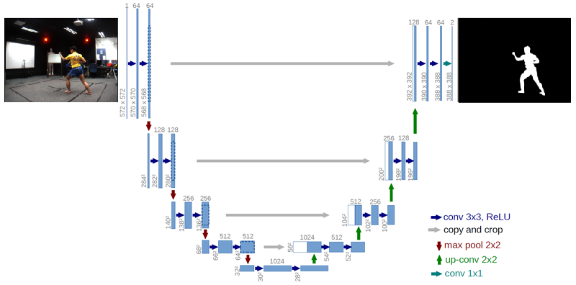
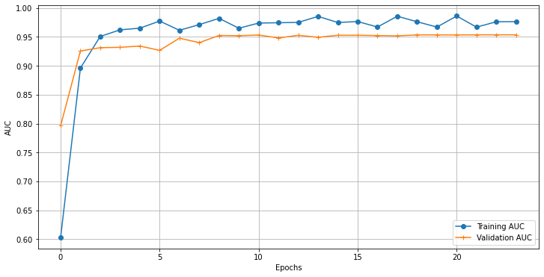
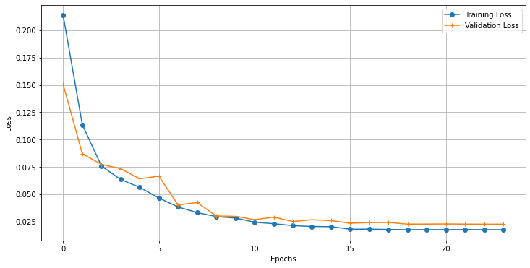
Unet-MODEL used for Semantic Segmentation:
Evaluation metrics
(AUC + BinaryCrossentropy Loss):

Slide 9
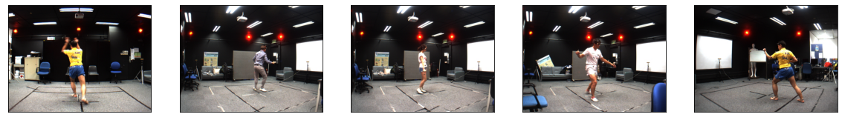
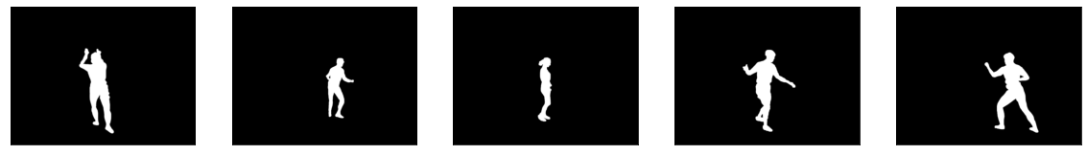
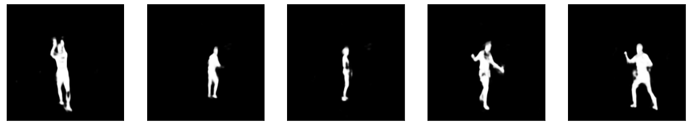
Results:

Slide 10
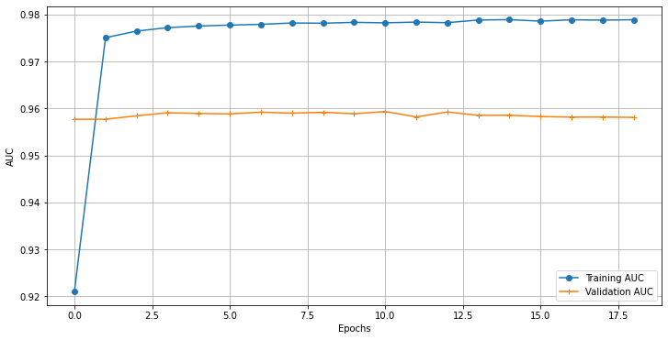
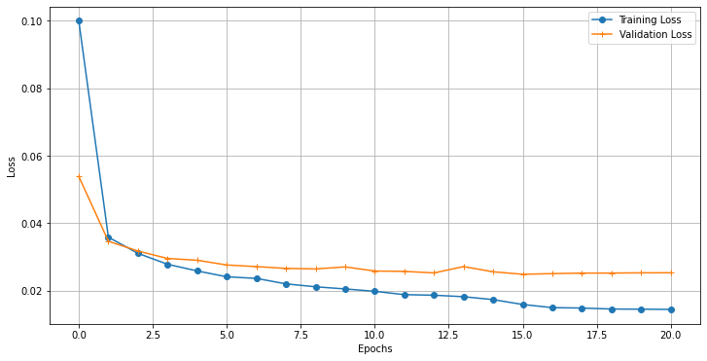
(Unet+ Xception)-MODEL used for Semantic Segmentation:
Evaluation metrics
(AUC + BinaryCrossentropy Loss):

Slide 11
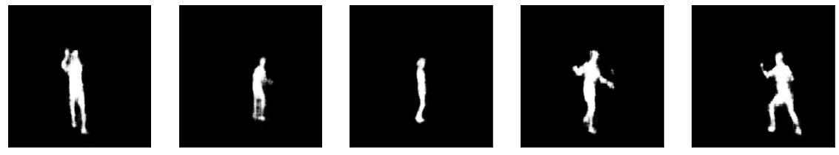
Results:

Slide 12
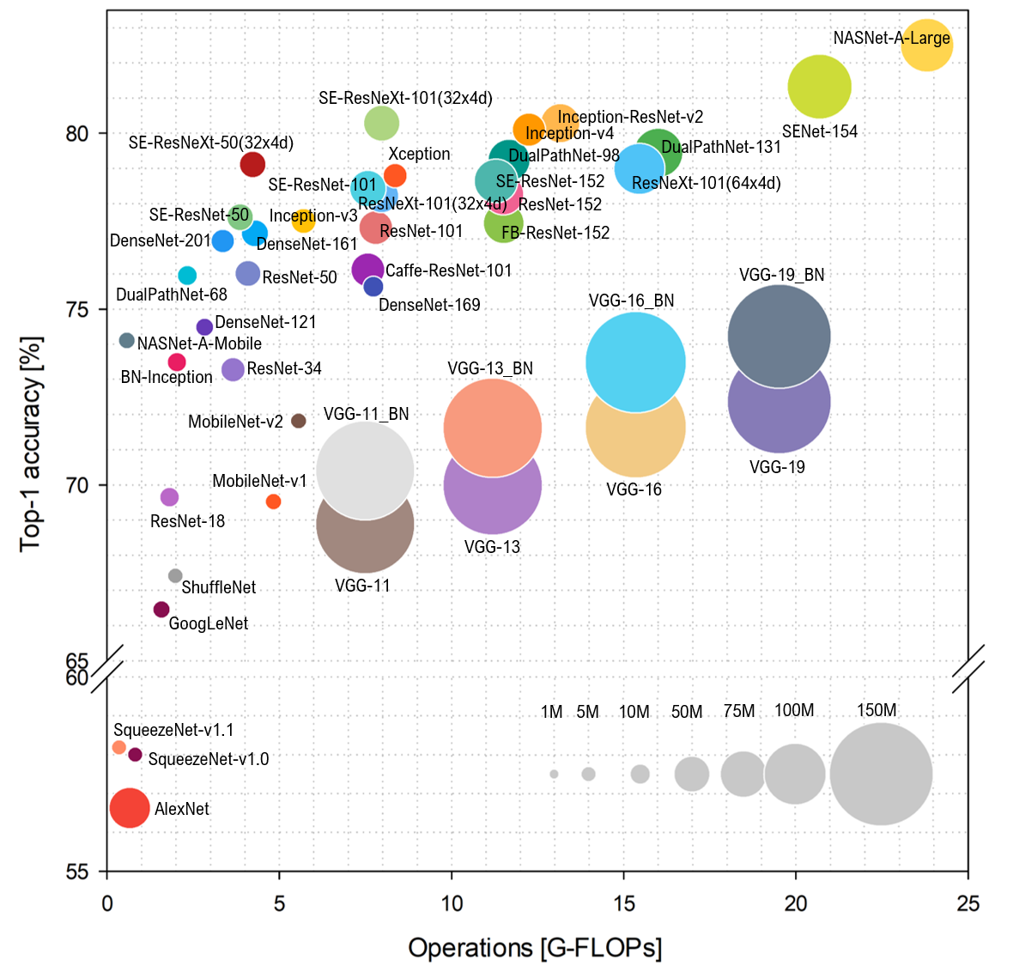
CNN model benchmarks
Encoder-Decoder Based State of the art Image Segmentation
State of the art Image Classification
◦ Unet
◦ U2net
◦ Vnet
◦ Enet
◦ BoxEnet

Slide 13
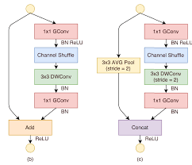
Proposing new methodology
● Better Pre-trained Model as an Encoder
● Res-Net Blocks
● Multi-Stage Training
● Ensembling Techniques
● Hyper-Parameter Tunning
● Data Augmentation

Slide 14
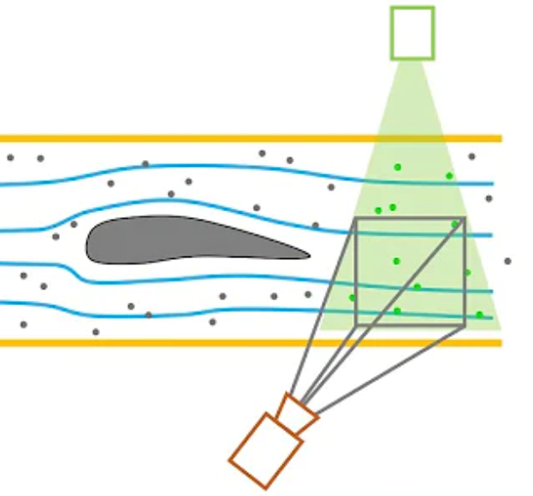
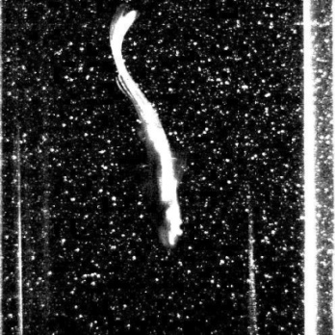
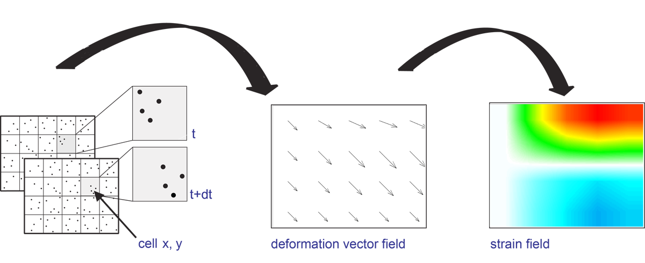
PIV and DIC
Particle Image Velocimetry (PIV):
Digital Image Correlation (DIC):

Slide 15
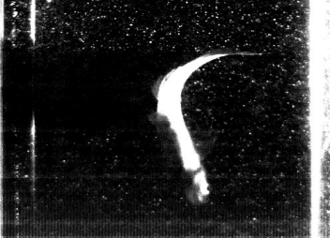

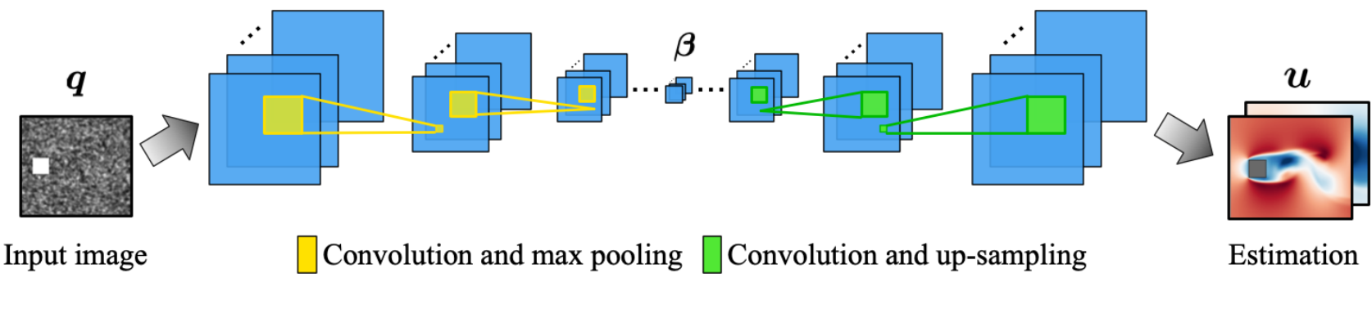

My intuition about the project
ML Pipeline:
Output
Particle image input
Image Segmentation @ML Model
Particle Velocity Field
@ML Model

Slide 16

Key Content Covered
Why CNN’s
Auto-Encoders and its Applications
Image Segmentation with Code
Proposing new methodology
CNN model benchmarks
PIV and DIC
My intuition about the project

Slide 17
Thank You

